Slide 1
ICCQIP Surveillance Update:Q20 Jan-Mar 2021 – Q26 Jul-Sep 2022
ICCQIP Surveillance Update: Q15 Oct-Dec 2019 – Q21 Apr-Jun 2021

Slide 2
Participation
 | Acute Trusts | All CCUs | Adult CCUs | Paediatric CCUs | Neonatal CCUs
Number in England | 139 | 428 | 240 | 25 | 163
Number registered on ICU Data Capture System | 131 | 285 | 237 | 21 | 27
Number with a registered Local Administrator | 97 | 164 | 144 | 6 | 14
Number which ever entered any data | 105 | 178 | 156 | 9 | 13
Number which have entered any data in last 7 quarters | 81 | 129 | 114 | 4 | 11
Number which have entered any data in Q26 Jul-Sep 2022 | 63 | 93 | 77 | 4 | 7
Notes:
updated

Slide 3
Active participation- Adult
Where units have submitted complete data for each quarter (both numerator and denominator)

Slide 4
Active participation
Where units have submitted complete data for each quarter (both numerator and denominator)

Slide 5
Active participation
Where units have submitted complete data for each quarter (both numerator and denominator)

Slide 6
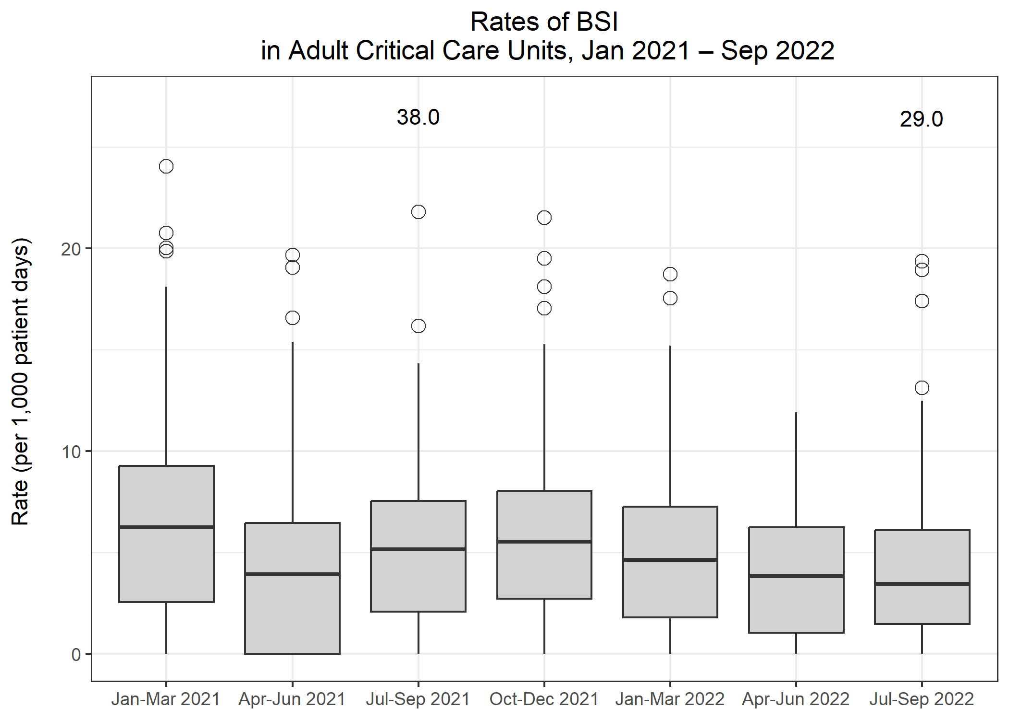
Rates of BSI in Adult CCUs
Metric | Q20 Jan-Mar 2021 | Q21 Apr-Jun 2021 | Q22 Jul-Sep 2021 | Q23 Oct-Dec 2021 | Q24 Jan-Mar 2022 | Q25 Apr-Jun 2022 | Q26 Jul-Sep 2022
Total number of positive blood cultures | 1,671 | 786 | 1,095 | 1,115 | 811 | 843 | 895
Total number of patient days | 117,810 | 90,665 | 97,270 | 98,462 | 89,201 | 96,938 | 98,145
Rate of positive blood cultures per 1,000 patient days | 14.2 | 8.7 | 11.3 | 11.3 | 9.1 | 8.7 | 9.1
Total number of positive blood cultures | 1,671 | 786 | 1,095 | 1,115 | 811 | 843 | 895
Total number of blood culture sets taken | 16,902 | 10,985 | 11,819 | 11,674 | 10,653 | 10,773 | 11,064
Rate of positive blood cultures per 1,000 blood culture sets taken | 98.9 | 71.6 | 92.6 | 95.5 | 76.1 | 78.3 | 80.9
Total number of BSIs | 856 | 441 | 598 | 617 | 448 | 437 | 465
Rate of BSI per 1,000 patient days | 7.3 | 4.9 | 6.1 | 6.3 | 5.0 | 4.5 | 4.7

Slide 7
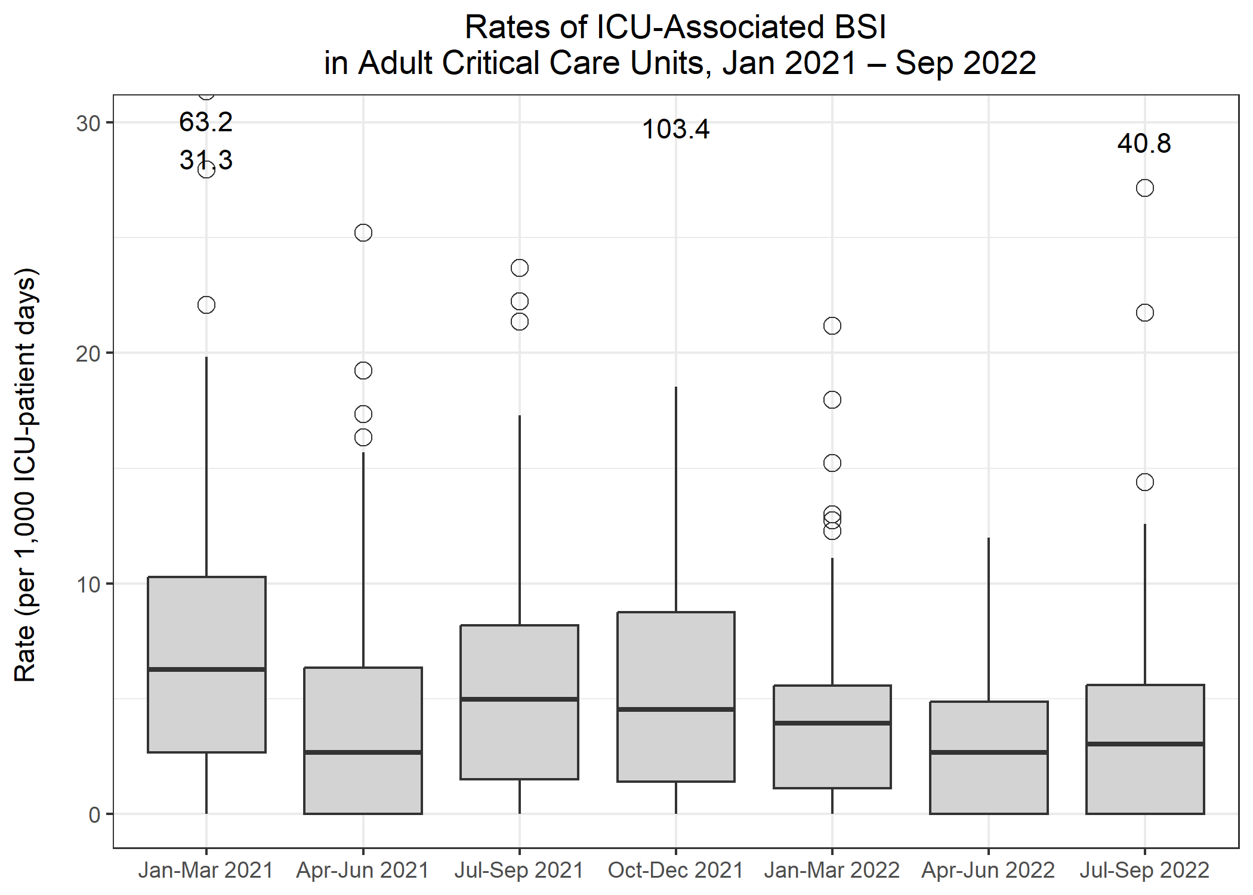
Rates of ICU-associated BSI in Adult CCUs
Metric | Q20 Jan-Mar 2021 | Q21 Apr-Jun 2021 | Q22 Jul-Sep 2021 | Q23 Oct-Dec 2021 | Q24 Jan-Mar 2022 | Q25 Apr-Jun 2022 | Q26 Jul-Sep 2022
Number of ICU-associated BSIs | 741 | 310 | 452 | 443 | 300 | 254 | 303
Number of patient days, amongst patients in the ICU>2 days | 95,461 | 66,134 | 72,340 | 74,700 | 65,792 | 70,865 | 70,708
Rate of ICU-associated BSI per 1,000 ICU-patient days | 7.8 | 4.7 | 6.2 | 5.9 | 4.6 | 3.6 | 4.3

Slide 8
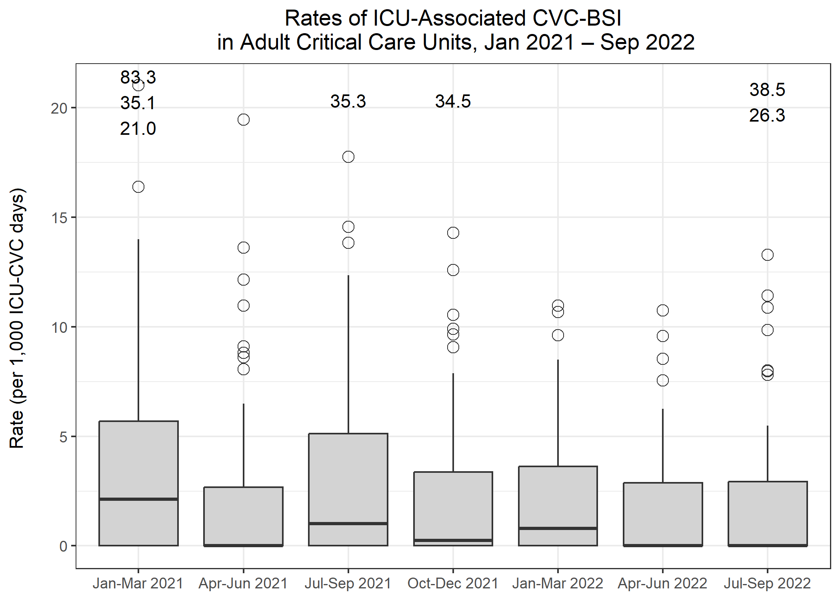
Rates of ICU-associated CVC-BSI in Adult CCUs
Metric | Q20 Jan-Mar 2021 | Q21 Apr-Jun 2021 | Q22 Jul-Sep 2021 | Q23 Oct-Dec 2021 | Q24 Jan-Mar 2022 | Q25 Apr-Jun 2022 | Q26 Jul-Sep 2022
Number of ICU-associated CVC-associated BSIs | 120 | 67 | 82 | 78 | 56 | 61 | 65
Number of CVC days, amongst patients in the ICU>2 days | 61,751 | 41,890 | 44,836 | 46,680 | 39,691 | 41,361 | 40,331
Rate of ICU-associated CVC-associated BSI per 1,000 ICU-CVC days | 1.9 | 1.6 | 1.8 | 1.7 | 1.4 | 1.5 | 1.6
Number of ICU-associated CVC-related BSI | 151 | 69 | 108 | 66 | 60 | 47 | 50
Rate of ICU-associated CVC-related BSI per 1,000 ICU-CVC days | 2.4 | 1.6 | 2.4 | 1.4 | 1.5 | 1.1 | 1.2
Number of all ICU-associated CVC-BSI | 232 | 117 | 155 | 120 | 98 | 82 | 97
Rate of all ICU-associated CVC-BSI per 1,000 ICU-CVC days | 3.8 | 2.8 | 3.5 | 2.6 | 2.5 | 2.0 | 2.4
CVC utilisation | 64.7% | 63.3% | 62.0% | 62.5% | 60.3% | 58.4% | 57.0%

Slide 9
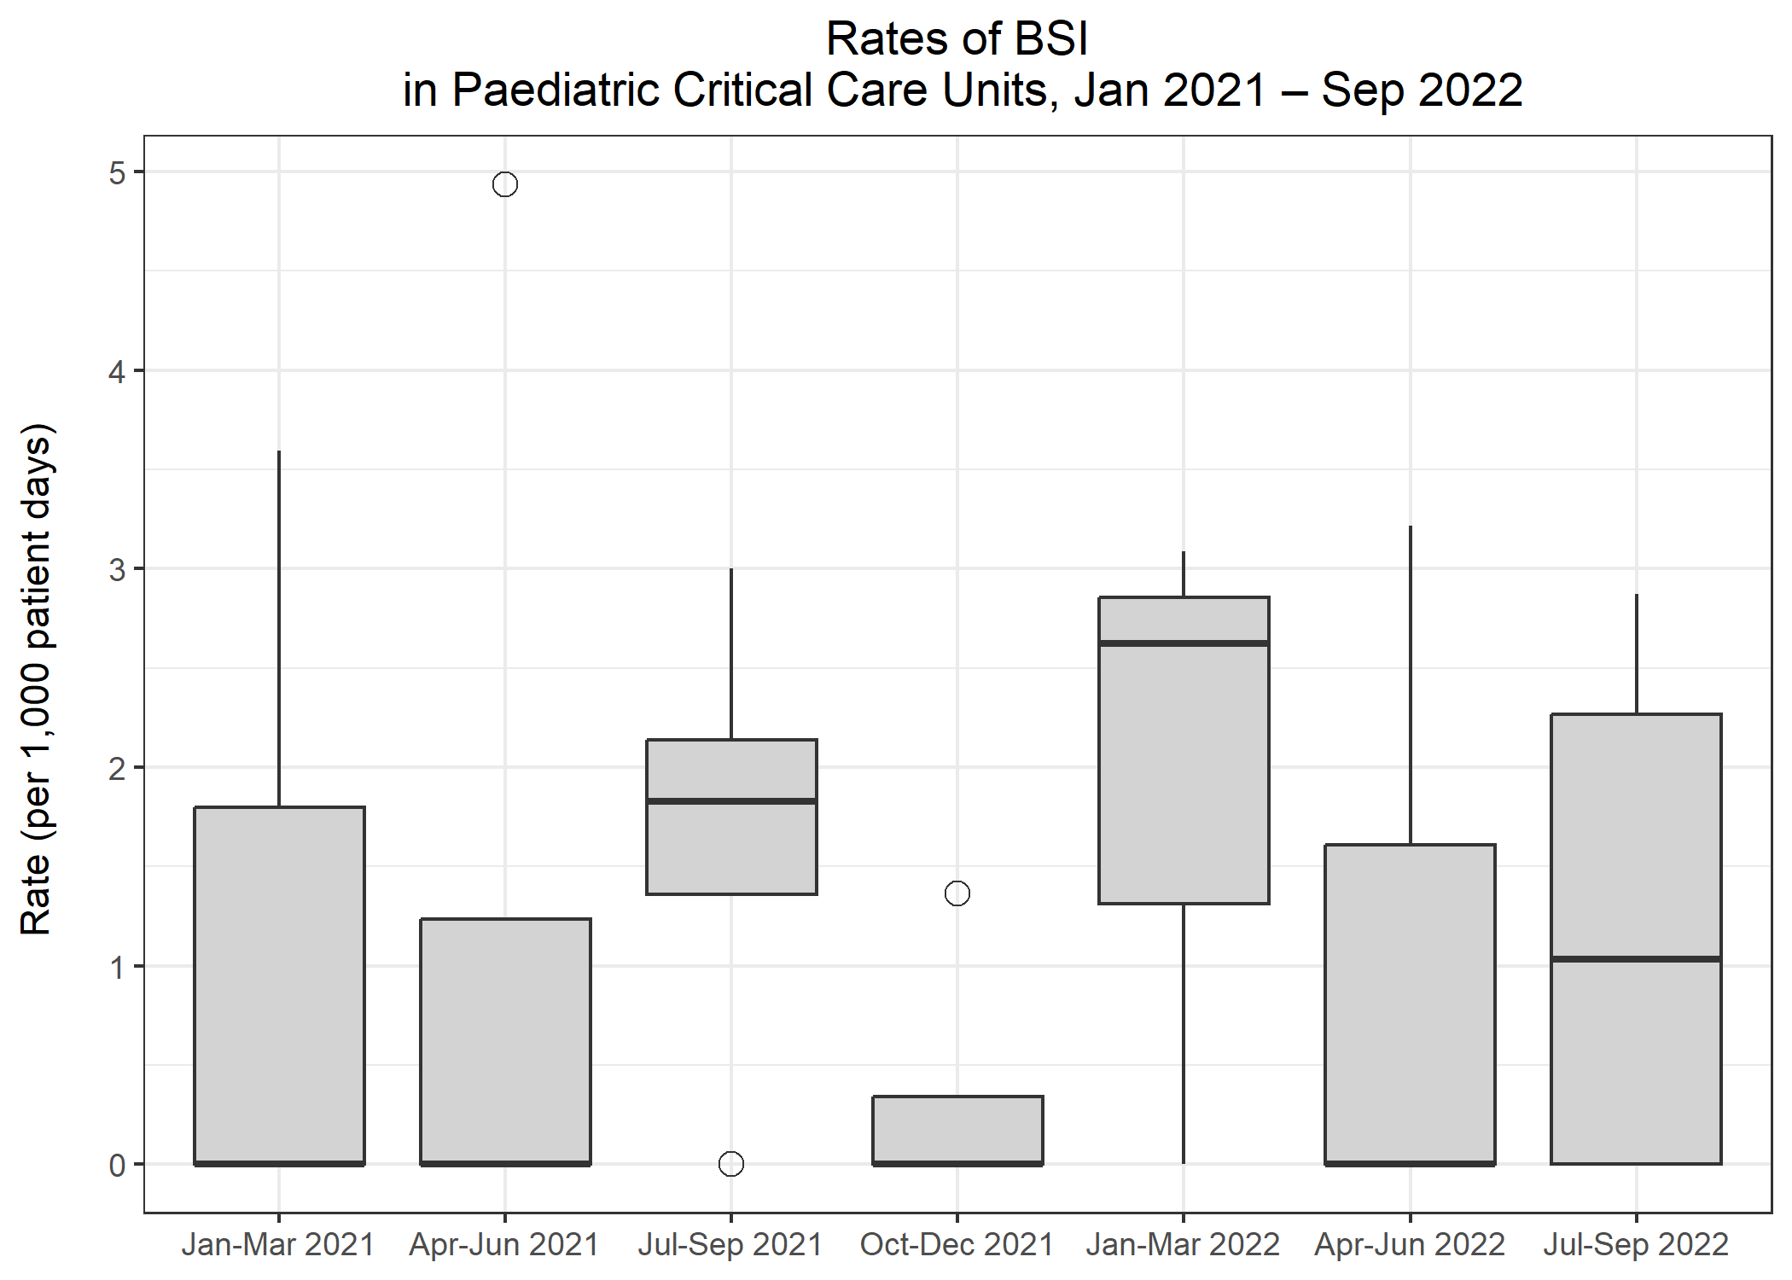
Rates of BSI in Paediatric CCUs
Metric | Q20 Jan-Mar 2021 | Q21 Apr-Jun 2021 | Q22 Jul-Sep 2021 | Q23 Oct-Dec 2021 | Q24 Jan-Mar 2022 | Q25 Apr-Jun 2022 | Q26 Jul-Sep 2022
Total number of positive blood cultures | 2 | 5 | 7 | 8 | 4 | 2 | 6
Total number of patient days | 1,030 | 1,151 | 2,224 | 1,623 | 1,155 | 1,120 | 1,640
Rate of positive blood cultures per 1,000 patient days | 1.9 | 4.3 | 3.1 | 4.9 | 3.5 | 1.8 | 3.7
Total number of positive blood cultures | 2 | 5 | 7 | 8 | 4 | 2 | 6
Total number of blood culture sets taken | 129 | 116 | 215 | 139 | 99 | 119 | 161
Rate of positive blood cultures per 1,000 blood culture sets taken | 15.5 | 43.1 | 32.6 | 57.6 | 40.4 | 16.8 | 37.3
Total number of BSIs | 1 | 2 | 5 | 1 | 3 | 2 | 3
Rate of BSI per 1,000 patient days | 1.0 | 1.7 | 2.2 | 0.6 | 2.6 | 1.8 | 1.8

Slide 10
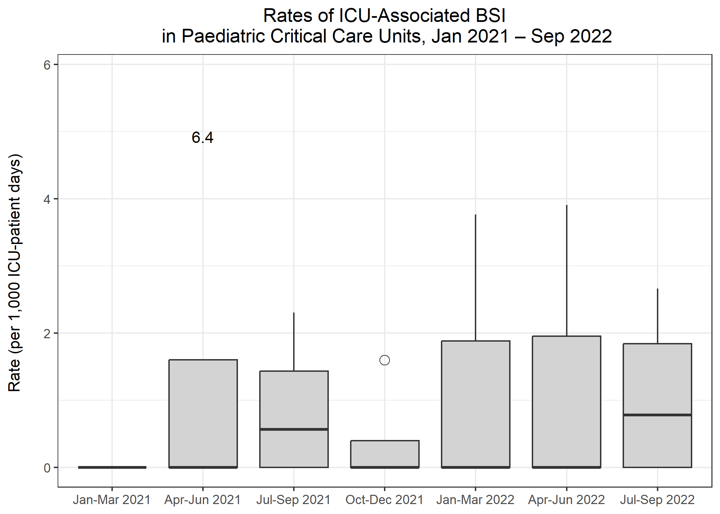
Rates of ICU-associated BSI in Paediatric CCUs
Metric | Q20 Jan-Mar 2021 | Q21 Apr-Jun 2021 | Q22 Jul-Sep 2021 | Q23 Oct-Dec 2021 | Q24 Jan-Mar 2022 | Q25 Apr-Jun 2022 | Q26 Jul-Sep 2022
Number of ICU-associated BSIs | 0 | 2 | 2 | 1 | 2 | 2 | 2
Number of patient days, amongst patients in the ICU>2 days | 826 | 857 | 1,708 | 1,276 | 871 | 846 | 1,293
Rate of ICU-associated BSI per 1,000 ICU-patient days | 0.0 | 2.3 | 1.2 | 0.8 | 2.3 | 2.4 | 1.5

Slide 11
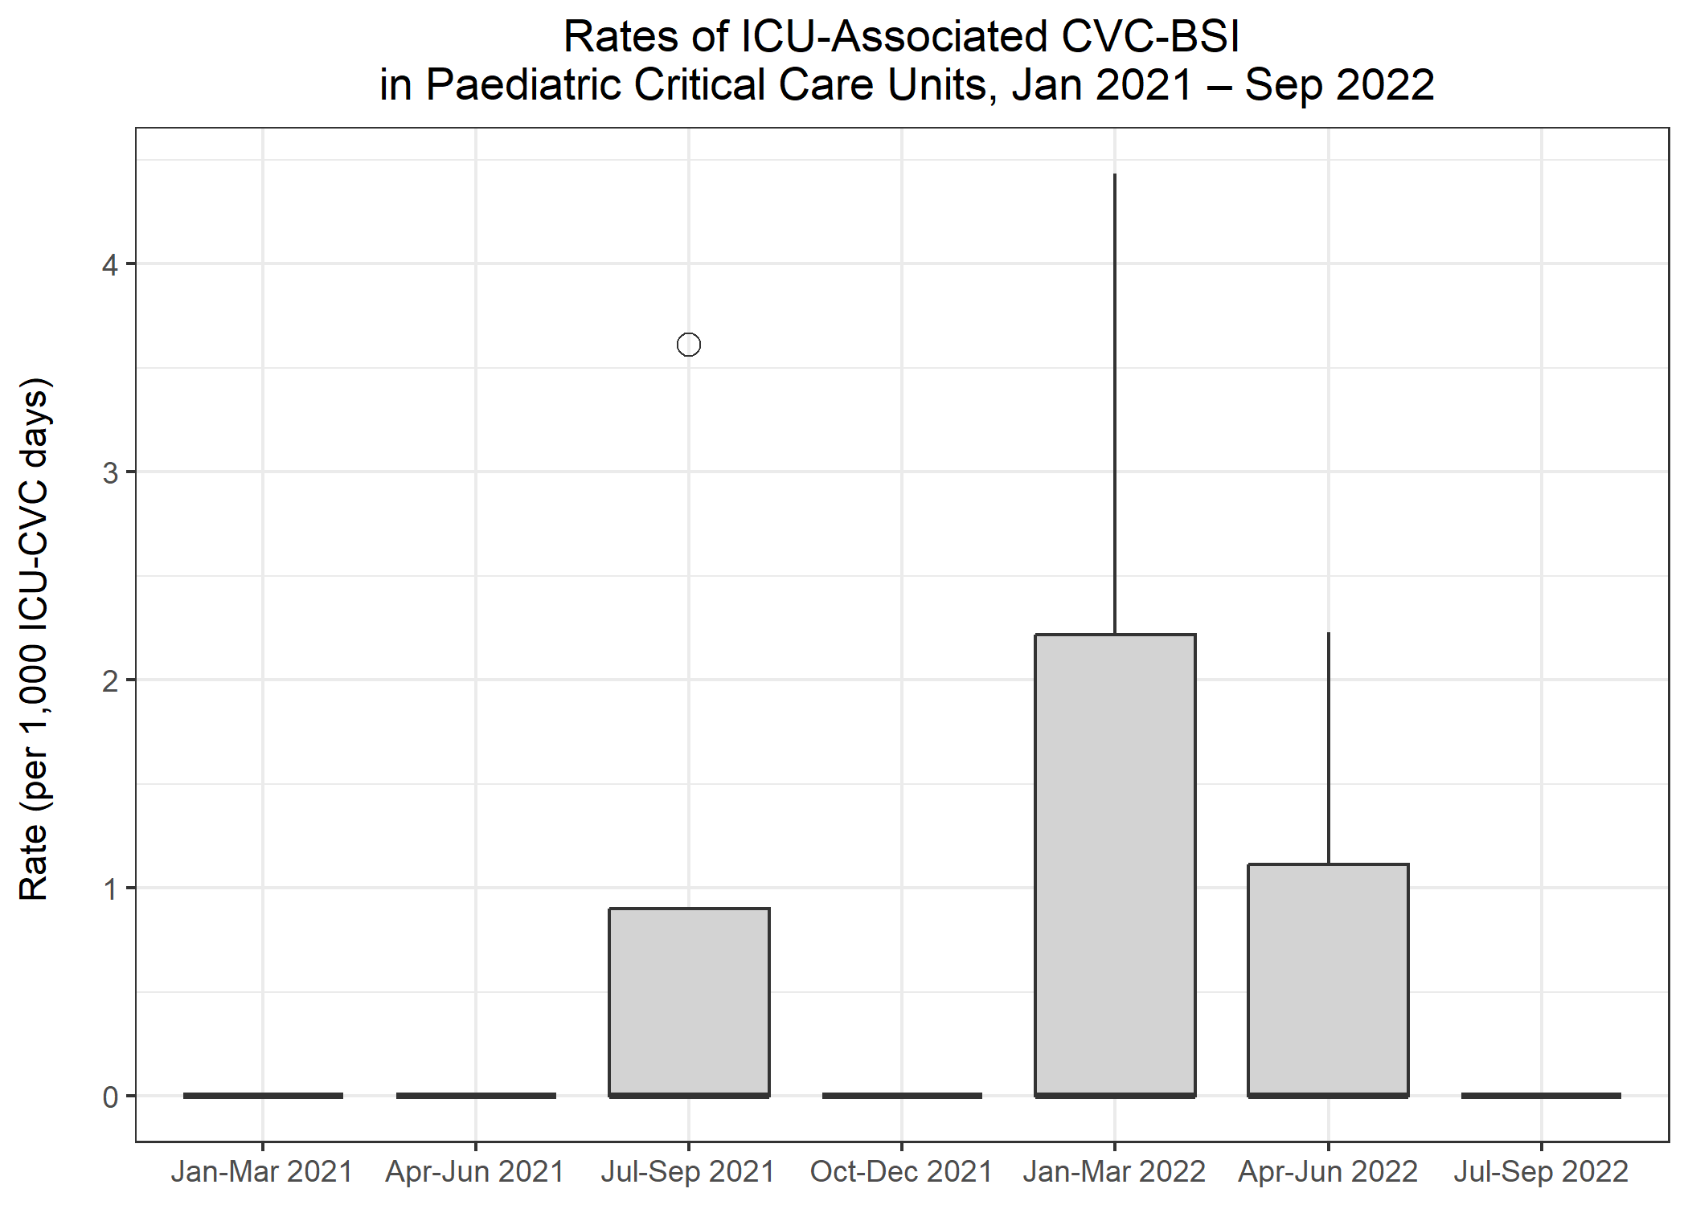
Rates of ICU-associated CVC-BSI in Paediatric CCUs
Metric | Q20 Jan-Mar 2021 | Q21 Apr-Jun 2021 | Q22 Jul-Sep 2021 | Q23 Oct-Dec 2021 | Q24 Jan-Mar 2022 | Q25 Apr-Jun 2022 | Q26 Jul-Sep 2022
Number of ICU-associated CVC-associated BSIs | 0 | 0 | 1 | 0 | 2 | 0 | 0
Number of CVC days, amongst patients in the ICU>2 days | 446 | 506 | 745 | 758 | 673 | 639 | 712
Rate of ICU-associated CVC-associated BSI per 1,000 ICU-CVC days | 0.0 | 0.0 | 1.3 | 0.0 | 3.0 | 0.0 | 0.0
Number of ICU-associated CVC-related BSI | 0 | 0 | 0 | 0 | 0 | 1 | 0
Rate of ICU-associated CVC-related BSI per 1,000 ICU-CVC days | 0.0 | 0.0 | 0.0 | 0.0 | 0.0 | 1.6 | 0.0
Number of all ICU-associated CVC-BSI | 0 | 0 | 1 | 0 | 2 | 1 | 0
Rate of all ICU-associated CVC-BSI per 1,000 ICU-CVC days | 0.0 | 0.0 | 1.3 | 0.0 | 3.0 | 1.6 | 0.0
CVC utilisation | 54.0% | 59.0% | 43.6% | 59.4% | 77.3% | 75.5% | 55.1%

Slide 12
Rates of BSI in Neonatal CCUs
Metric | Q20 Jan-Mar 2021 | Q21 Apr-Jun 2021 | Q22 Jul-Sep 2021 | Q23 Oct-Dec 2021 | Q24 Jan-Mar 2022 | Q25 Apr-Jun 2022 | Q26 Jul-Sep 2022
Total number of positive blood cultures | 20 | 31 | 34 | 38 | 44 | 29 | 33
Total number of patient days | 8,283 | 7,772 | 9,832 | 9,999 | 10,067 | 10,383 | 8,784
Rate of positive blood cultures per 1,000 patient days | 2.4 | 4.0 | 3.5 | 3.8 | 4.4 | 2.8 | 3.8
Total number of positive blood cultures | 20 | 31 | 34 | 38 | 44 | 29 | 33
Total number of blood culture sets taken | 591 | 531 | 730 | 622 | 647 | 729 | 526
Rate of positive blood cultures per 1,000 blood culture sets taken* | 33.8 | 58.4 | 46.6 | 61.1 | 68.0 | 39.8 | 62.7
Total number of BSIs | 1 | 4 | 9 | 8 | 12 | 9 | 9
Rate of BSI per 1,000 patient days | 0.1 | 0.5 | 0.9 | 0.8 | 1.2 | 0.9 | 1.0

Slide 13
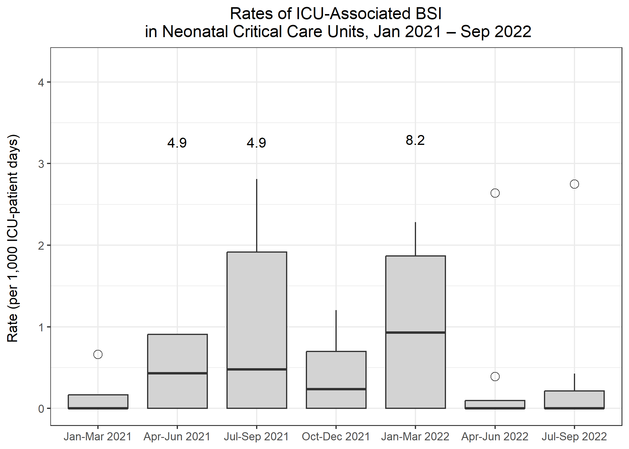
Rates of ICU-associated BSI in Neonatal CCUs
Metric | Q20 Jan-Mar 2021 | Q21 Apr-Jun 2021 | Q22 Jul-Sep 2021 | Q23 Oct-Dec 2021 | Q24 Jan-Mar 2022 | Q25 Apr-Jun 2022 | Q26 Jul-Sep 2022
Number of ICU-associated BSIs | 1 | 4 | 8 | 6 | 12 | 7 | 7
Number of patient days, amongst patients in the ICU>2 days | 7,905 | 7,384 | 9,200 | 9,608 | 9,675 | 9,577 | 8,422
Rate of ICU-associated BSI per 1,000 ICU-patient days | 0.1 | 0.5 | 0.9 | 0.6 | 1.2 | 0.7 | 0.8

Slide 14
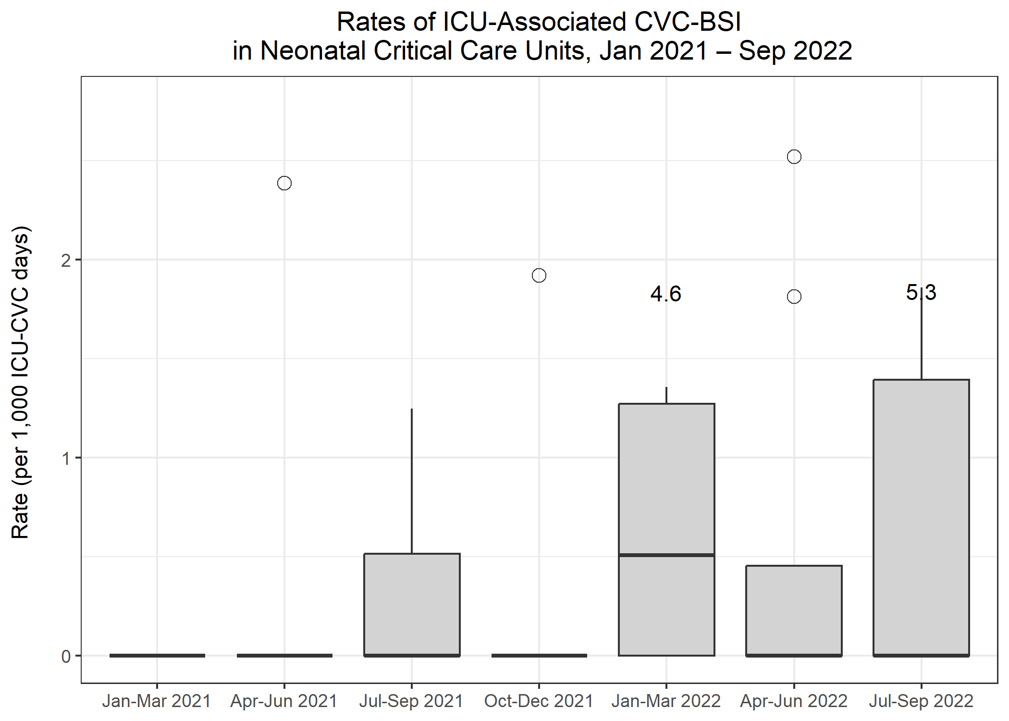
Rates of ICU-associated CVC-BSI in Neonatal CCUs
Metric | Q20 Jan-Mar 2021 | Q21 Apr-Jun 2021 | Q22 Jul-Sep 2021 | Q23 Oct-Dec 2021 | Q24 Jan-Mar 2022 | Q25 Apr-Jun 2022 | Q26 Jul-Sep 2022
Number of ICU-associated CVC-associated BSIs | 0 | 1 | 2 | 1 | 3 | 3 | 4
Number of CVC days, amongst patients in the ICU>2 days | 1,875 | 1,828 | 2,600 | 2,652 | 2,591 | 2,283 | 1,883
Rate of ICU-associated CVC-associated BSI per 1,000 ICU-CVC days | 0.0 | 0.5 | 0.8 | 0.4 | 1.2 | 1.3 | 2.1
Number of ICU-associated CVC-related BSI | 0 | 0 | 2 | 0 | 2 | 1 | 3
Rate of ICU-associated CVC-related BSI per 1,000 ICU-CVC days | 0.0 | 0.0 | 0.8 | 0.0 | 0.8 | 0.4 | 1.6
Number of all ICU-associated CVC-BSI | 0 | 1 | 2 | 1 | 4 | 3 | 5
Rate of all ICU-associated CVC-BSI per 1,000 ICU-CVC days | 0.0 | 0.5 | 0.8 | 0.4 | 1.5 | 1.3 | 2.7
CVC utilisation | 23.7% | 24.8% | 28.3% | 27.6% | 26.8% | 23.8% | 22.4%

Slide 15
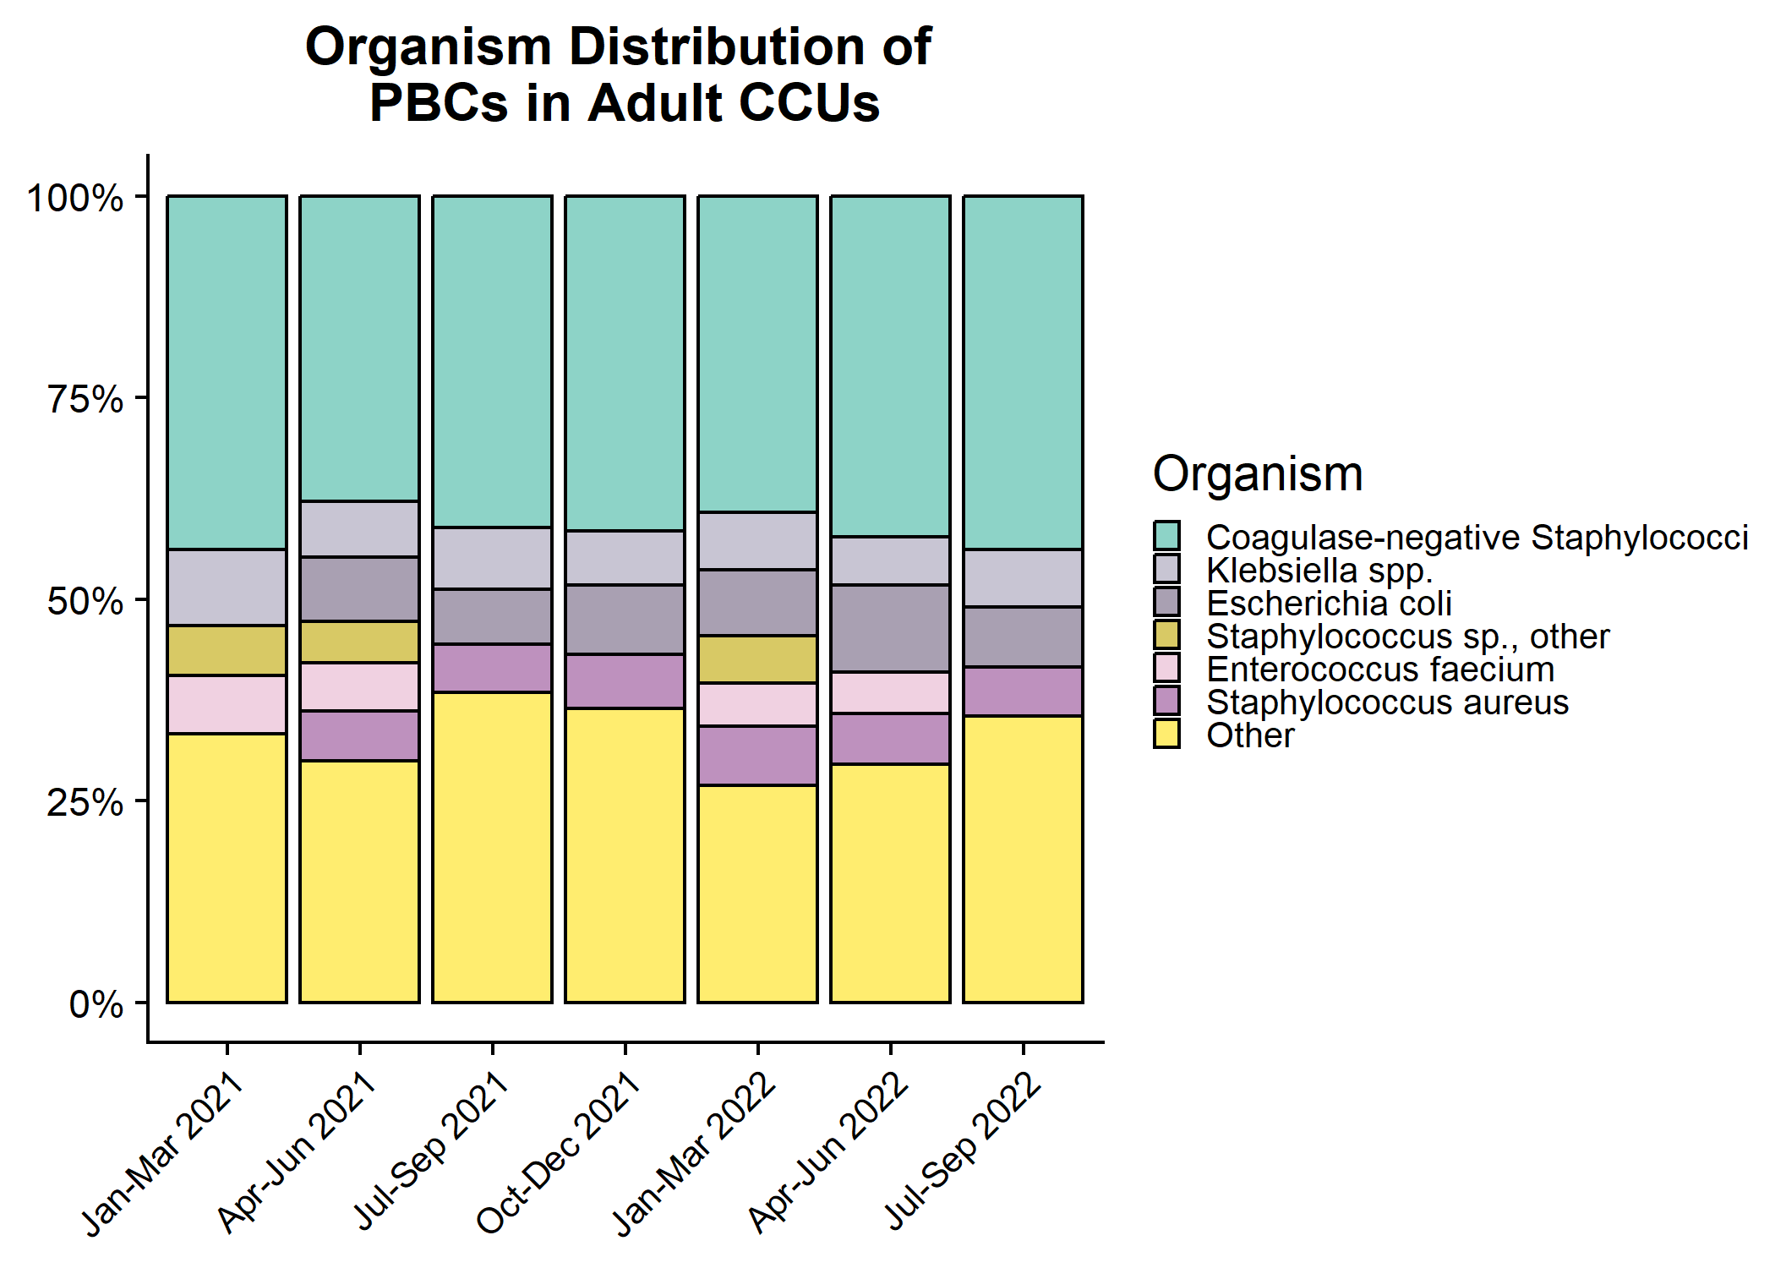
Organism distribution: all PBCs in Adult CCUs

Slide 16
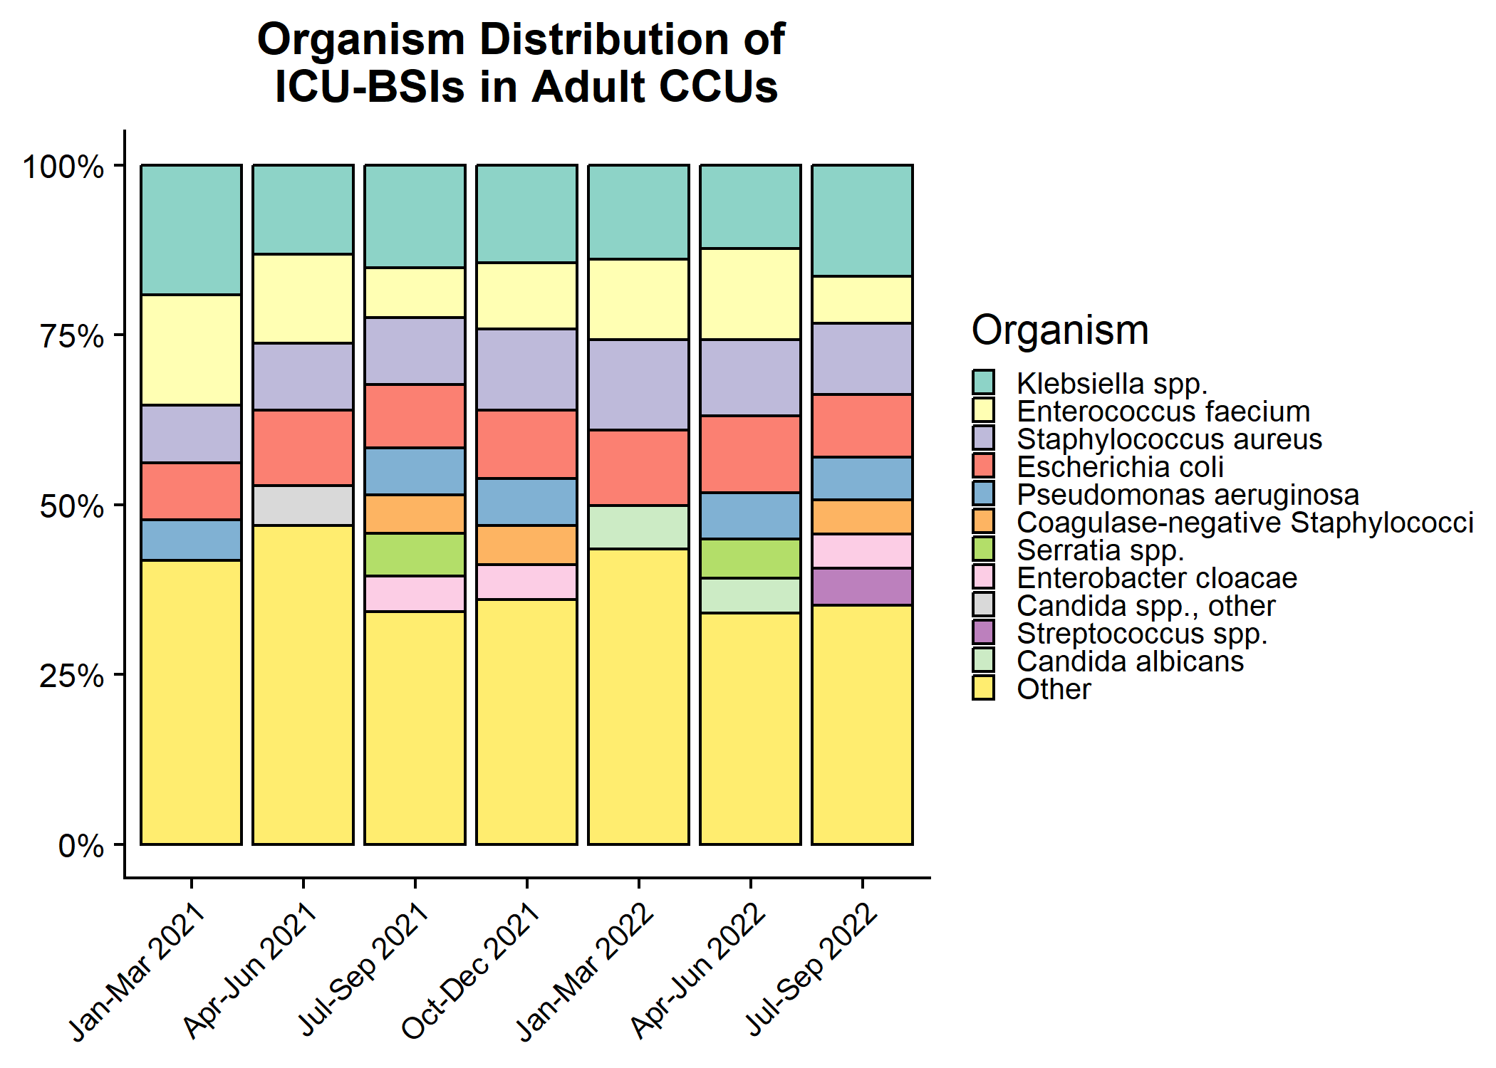
Organism distribution: ICU-associated BSIs in Adult CCUs

Slide 17
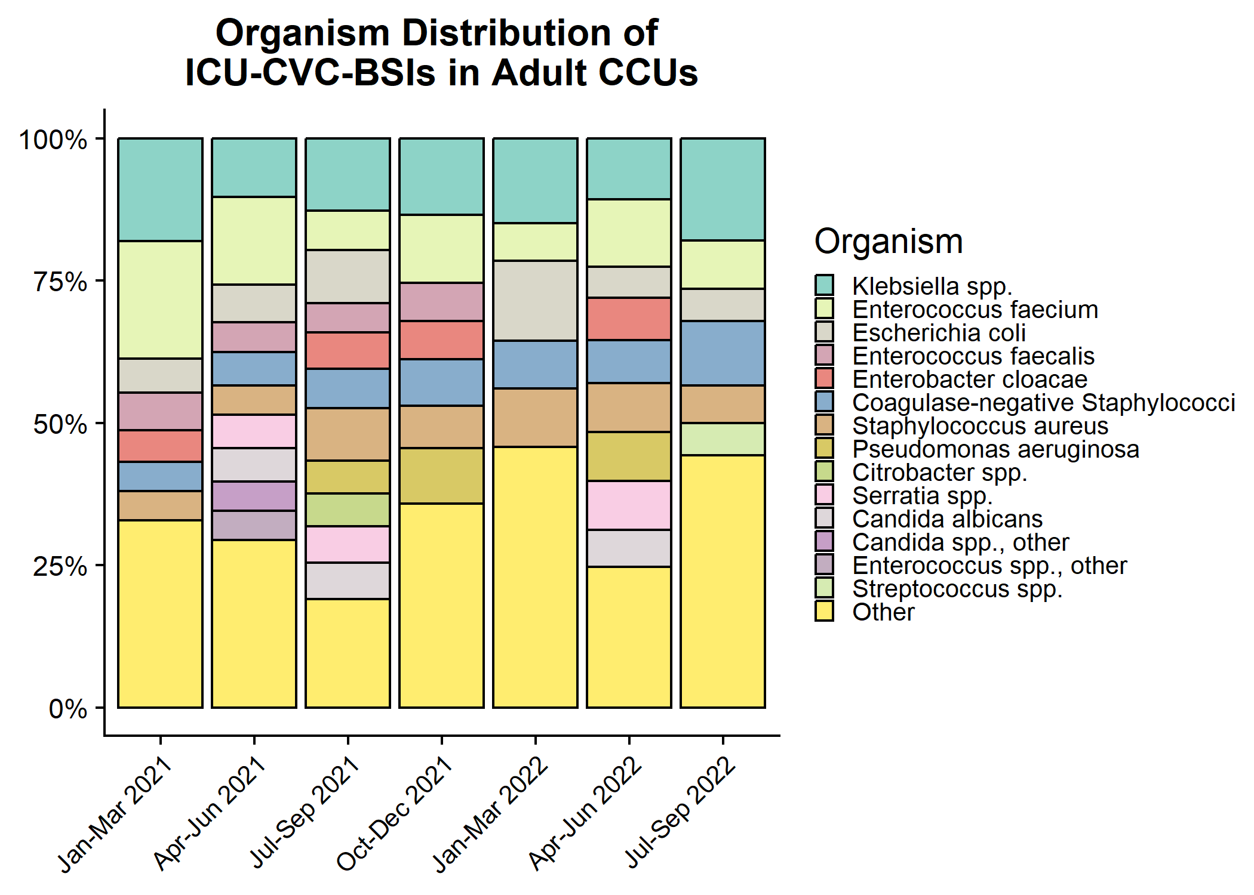
Organism distribution: ICU-CVC BSIs in Adult CCUs

Slide 18
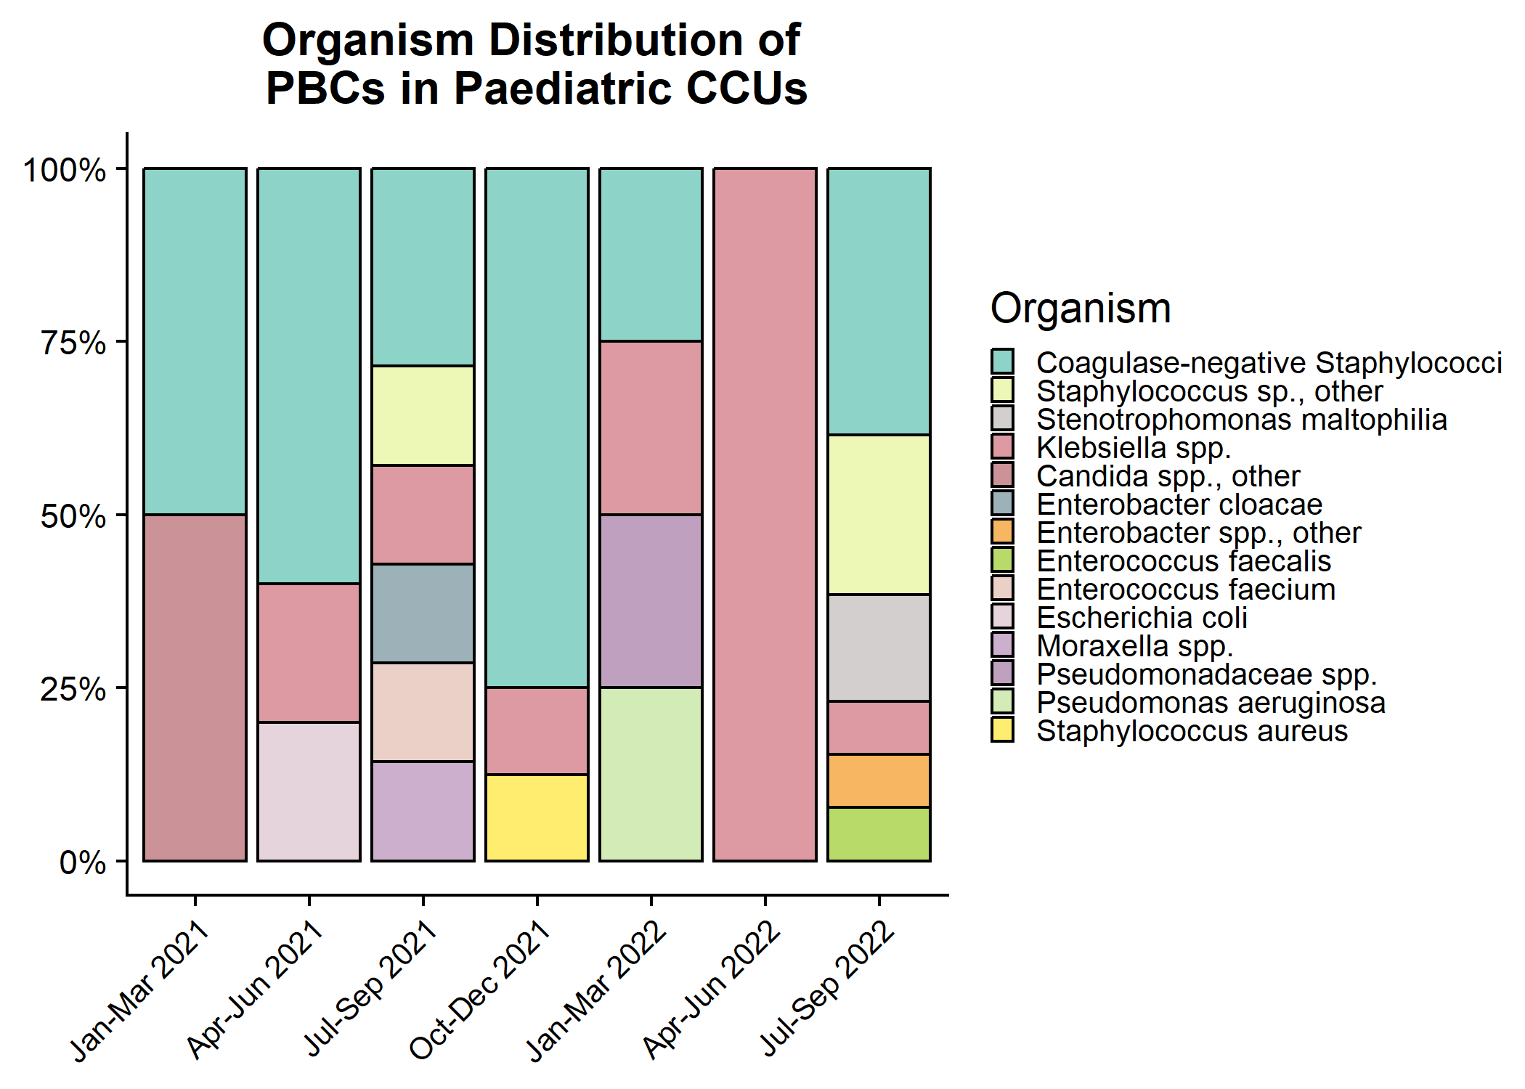
Organism distribution: all PBCs in Paediatric CCUs

Slide 19
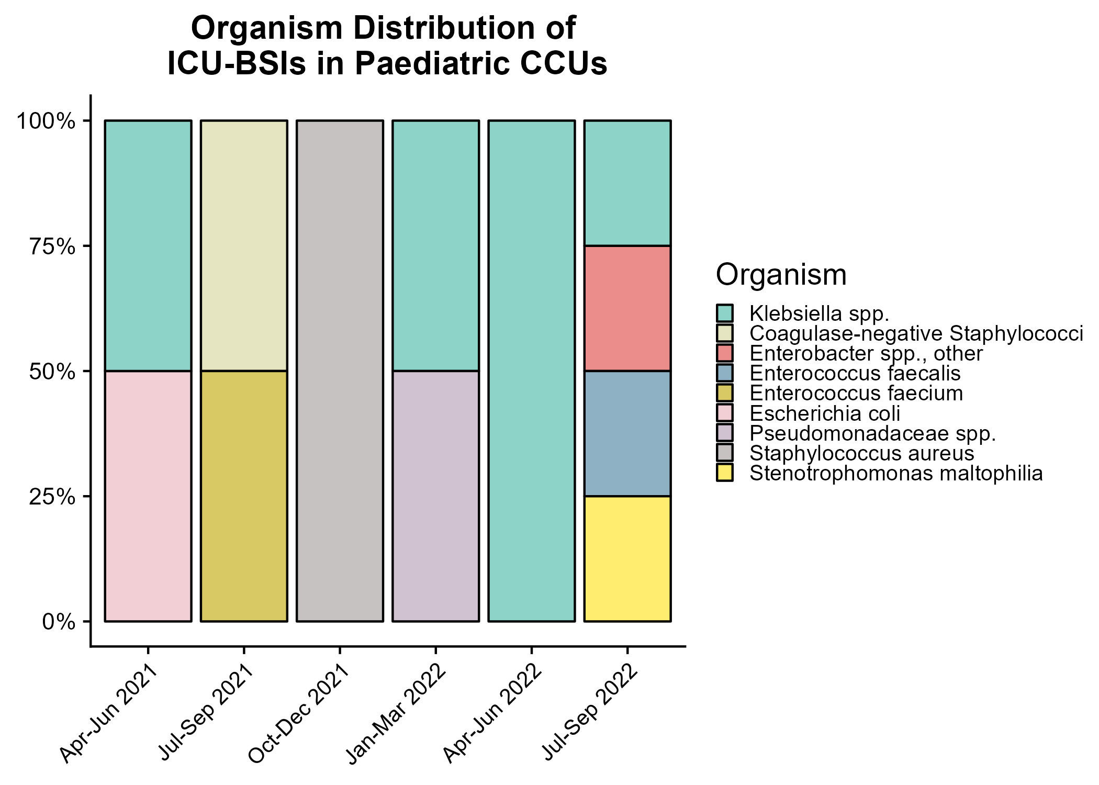
Organism distribution: ICU-associated BSIs in Paediatric CCUs

Slide 20
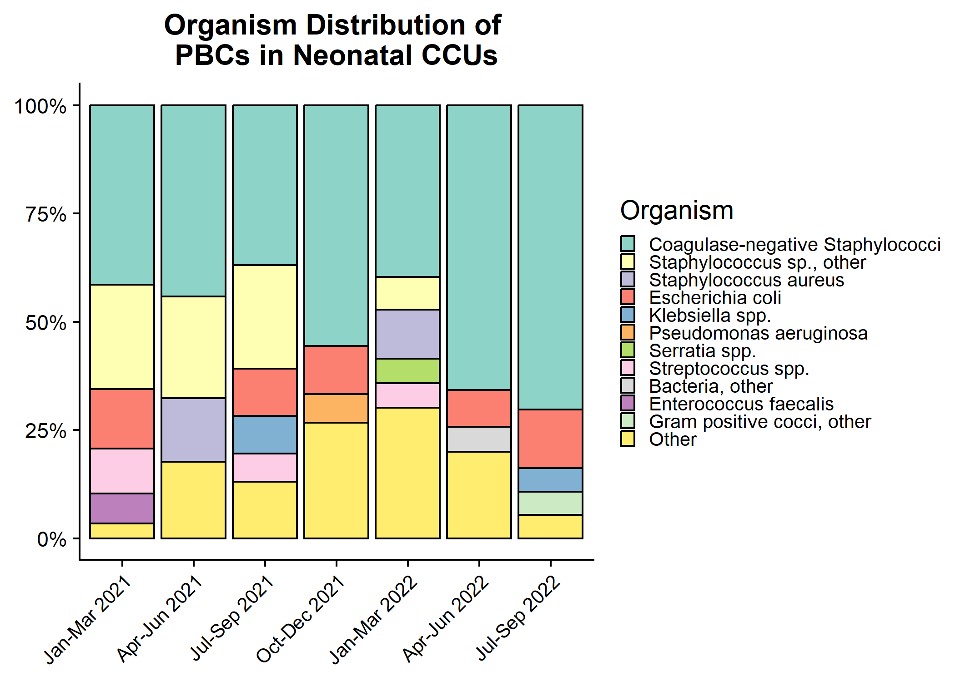
Organism distribution: all PBCs in Neonatal CCUs

Slide 21
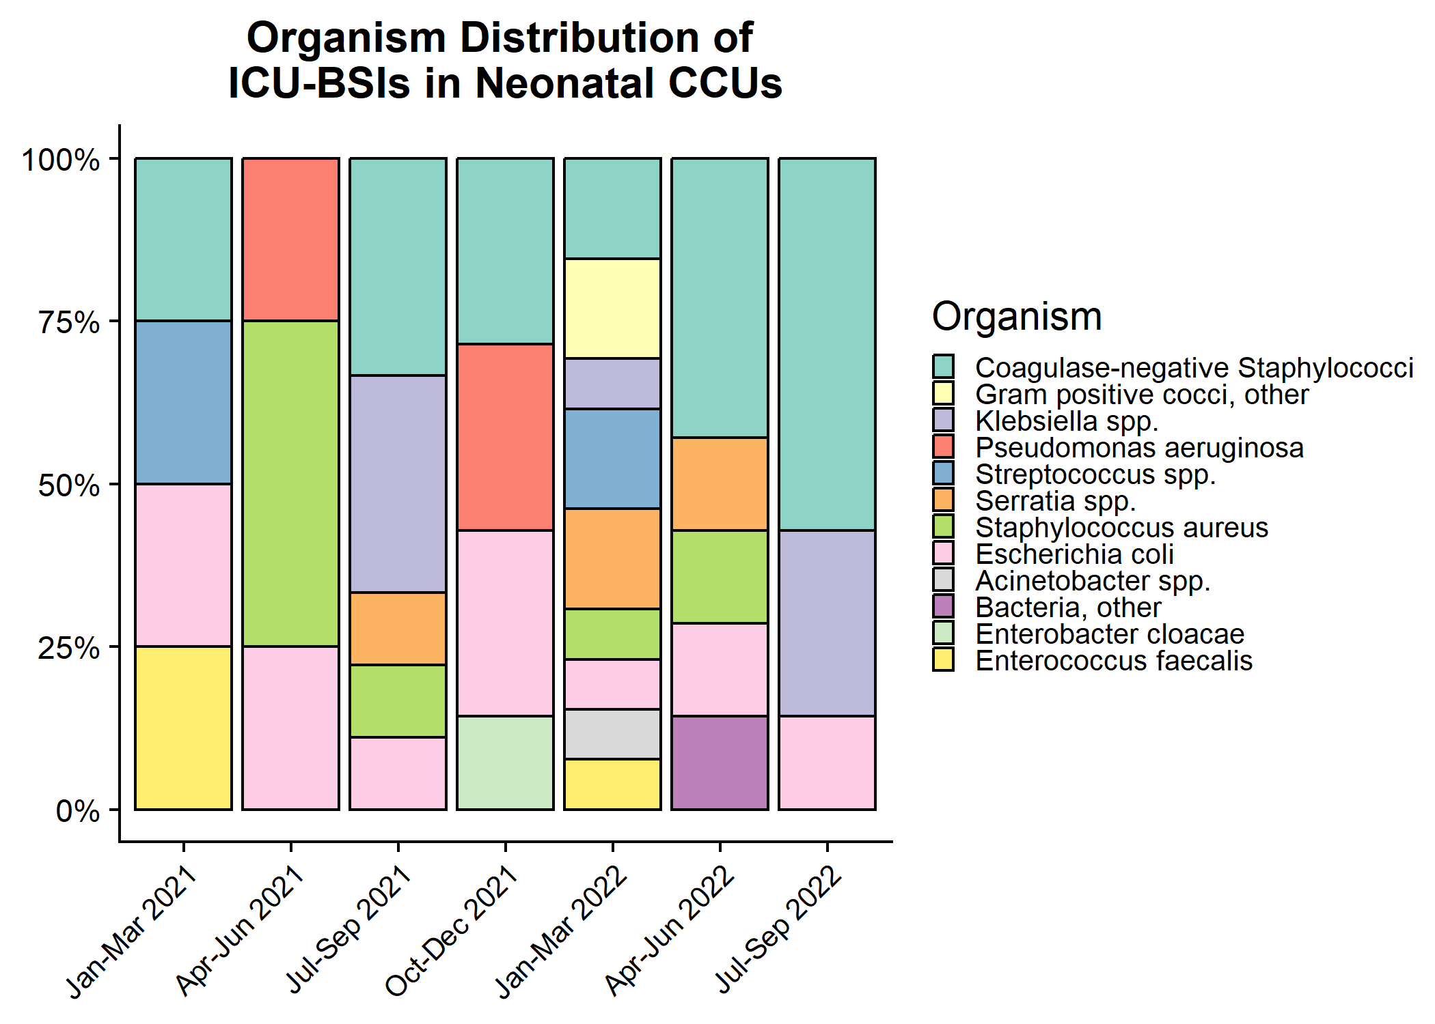
Organism distribution: ICU-associated BSIs in Neonatal CCUs

